Slide 1
COLUMBUS IRISH HERITAGE ASSOCIATION
St. Patrick's Festival 2027
Early planning, started January 2027. I organize this every year; getting ahead while the orchid show is behind me.

Slide 2
Workstreams
Venue and permits
Confirm the usual park pavilion and the city permit early.
Music
Book the trad session players, the bouzouki and whistle group from last year.
Food
Soda bread bake-off, stew vendors, a proper tea tent.
Family area
Emma helps run the kids' craft table.

Slide 3
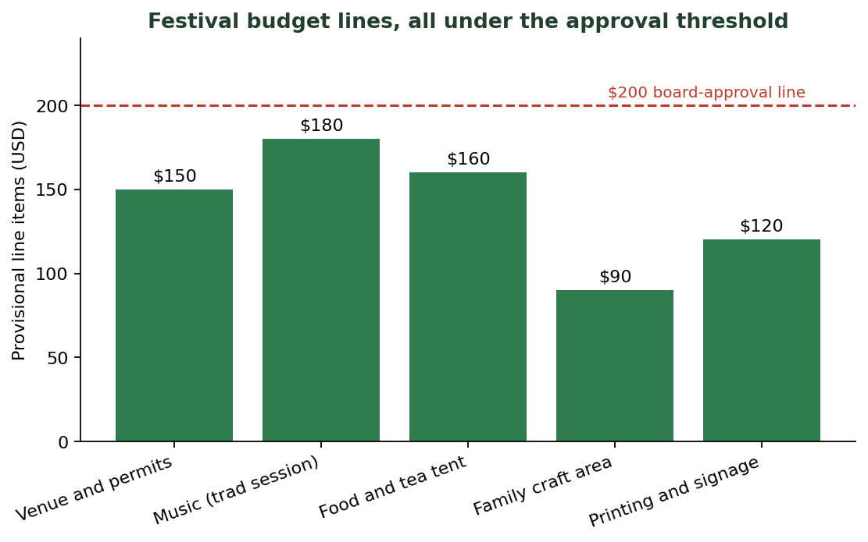
Provisional budget
• Every line held under the $200 board-approval threshold unless the board votes.
• Music and food are the two largest lines.
• Printing and signage reused where possible from last year.
Provisional line items against the approval line

Slide 4
Timeline to March
• January 2027: reserve the date and the space; email last year's volunteer list.
• February 2027: confirm music and food vendors; volunteer sign-up out.
• March 17, 2027: festival day.

Slide 5
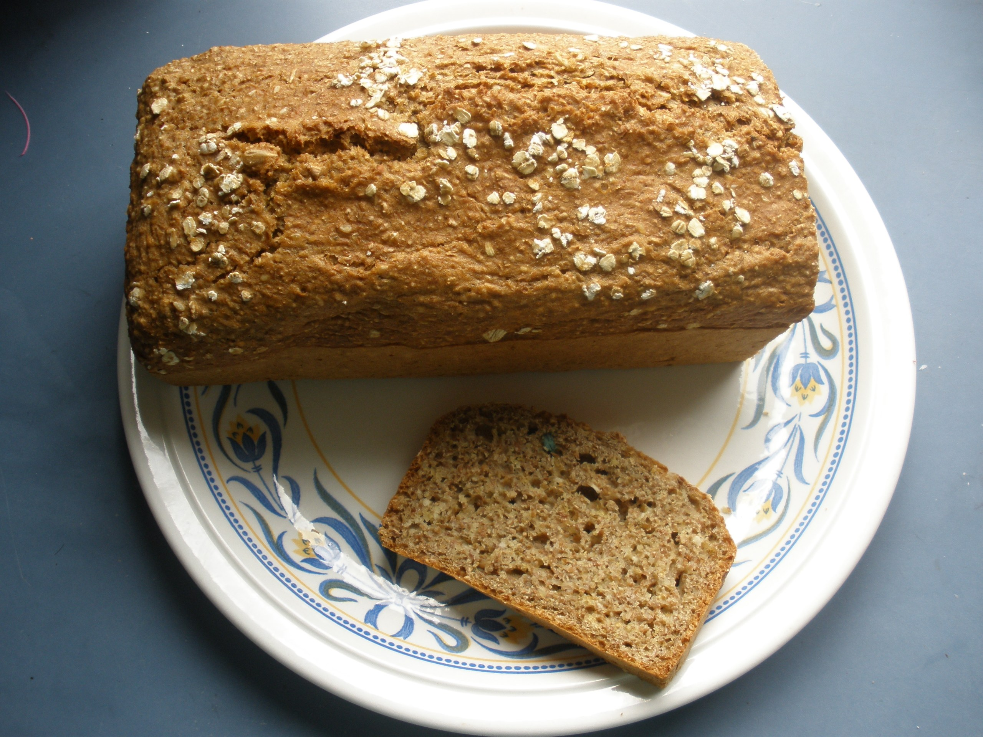
The tea tent and bake-off
Soda bread bake-off, the heart of the food area

Slide 6
Volunteers
• Online sign-up form out by end of January 2027.
• Reuse last year's roster as the first ask.
• Family area needs the most hands on the day.

Slide 7
Tone
• Keep it warm and community-first, not commercial.
• Mom always comes; it matters to her.

